Slide 1

LOGISTICS AND INVENTORY MANAGEMENT (LAIM)

Slide 2

Purpose
This app aims to provide user-friendly interface to automate operations related to sales, to track
Raw materials, furnished products availability and to place order.

Slide 3

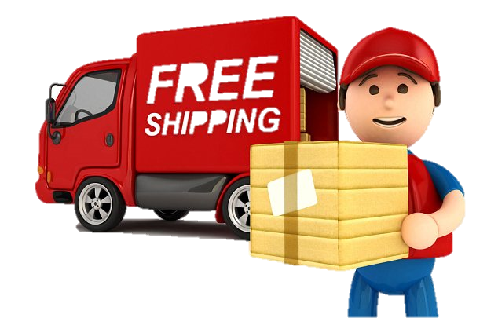

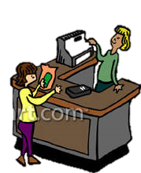
Users of the application
Delivery Boy
Administrator
Neev Manager

Slide 4
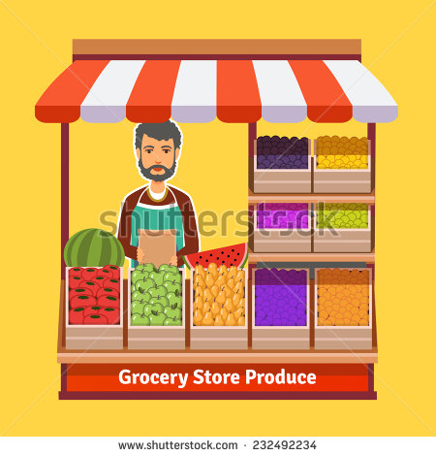
Privileges given to the users of the app :
Neev Manager –
Update and Track raw material
Update Furnished Products – Price and Quantity
Take orders from customers
Add/Update supplier Info
Maintain customer database
Export Information from database
Track sales and Inventory

Slide 5

Delivery Boy –
Update Transit orders
Update Delivered orders

Slide 6

Administrator –
Add new users to the app
Design modifications and enhancements to the app
Backend database and server maintenance
Security and Monitoring
Debugging and Error resolution

Slide 7
Internal Database
TABLE : SUPPLIER
Column name | Data type | Modifiers | Description
SID | Integer(Auto-increment) | Primary Key
Supplier_Name | Text |  | Name of the Supplier Company
Phone | Numeric (15) | Unique | Supplier Phone no.
Address | Text |  | Supplier Address
TABLE : customER
Column name | Data type | Modifiers | Description
Customer ID | Integer(Auto-increment) | Primary Key
Customer_Name | Text |  | Name of the Customer
Phone | Numeric (15) | Unique | Customer Phone no.
Address | Text |  | Customer Address

Slide 8
TABLE : RAW MATERIALS
Column name | Data type | Modifiers | Description
Item ID | Integer(Auto-increment) | Primary Key | ID of the bought Raw material
SID | Integer | Primary Key Foreign key(Supplier) | Supplier ID who supplied the raw material
Item name | Text |  | Name of the Raw material bought from the supplier
Quantity | Double |  | Quantity bought of the Raw material
Unit Price | Double |  | Cost Price of the raw material on this date
Date | Date | Primary Key | Date on which the raw material was supplied

Slide 9
TABLE : FURNISHED PRODUCTS
Column name | Data type | Modifiers | Description
Product ID | Integer(Auto-increment) | Primary Key | Unique ID given to each furnished product
Product Name | Text |  | Name of the furnished product
Product Price | Double | Unique | Furnished product price
Available Quantity | Unsigned Integer |  | Quantity available as of now
Status | Available or Out of Stock |  | To check whether furnished product is in stock or not.

Slide 10
TABLE : ORDER PRODUCTS
Column name | Data type | Modifiers | Description
Order ID | Integer(Auto-increment) | Primary Key | Unique Order ID
Product ID | Integer | Foreign Key(Furnished Products) | ID of the products ordered
Customer ID | Integer | Foreign Key (Customer) | ID of the customer who placed the order
Expected Quantity | Integer | Expected Quantity > 0 | Quantity ordered by the customer of each product
Booking Date | Date |  | Date on which the order was booked
Expected Delivery Date | Date | Expected Delivery Date >= Booking Date
Delivered On | Date |  | Delivered Date
Delivery Status | { In Process, In Transit, Delivered } |  | Status of the Order
Delivered Quantity | Integer | Delivered Quantity <= Expected Quantity | Quantity delivered to the customer against the ordered quantity
Unit Price | Double |  | Price of the Product at which the product was sold

Slide 11
TABLE : driver
Column name | Data type | Modifiers | Description
Driver ID | Integer(Auto-increment) | Primary Key | Unique ID of the Driver
Driver Name | Text |  | Name of the authorised driver
Driver Phone | Numeric (15) | Unique | Driver Phone no.
Driver Address | Text |  | Driver Address
TABLE : IN TRANSIT
Column name | Data type | Modifiers | Description
Order ID | Integer | Primary Key Foreign Key(Order Products)
Driver ID | Integer | Primary Key Foreign Key(Driver) | Driver who is on duty to deliver the order

Slide 12
TABLE : MATERIAL TRACK
Column name | Data type | Modifiers | Description
Item ID | Integer | Primary Key Foreign Key(Raw Materials) | Unique ID of the Raw material
Quantity | Double |  | Quantity available as of now

Slide 13
FEATURES OF THE SYSTEM
Raw material Supply Track
Customer Base Maintenance
Export data in PDF format
Transparent System

Slide 14
Software Requirements Specifications
The software product - LAIM will automate the major store-keeping operations.
First subsystem – App users' Registration
Second subsystem – Remote Database Updates and Retrieval

Slide 15
The SRS is organized into two main sections.
Overall Description
Specific Requirements
The Overall Description - describe the requirements of the LAIM from a general high level perspective.
The Specific Requirements section - describe in detail the requirements of the system.

Slide 16
OVERALL DESCRIPTION
Product Perspective - The LAIM is an independent stand– alone system.
Hardware Interfaces – Android OS with an active Internet connection
Software Interfaces - All databases for the LAIM will be configured using My SQL Workbench. Remote Server runs on Apache Tomcat v7.0
Development IDE – Eclipse Java EE IDE Mars.1 Release(4.5.1)

Slide 17
SPECIFIC REQUIREMENTS
U
S
E
R
I
N
T
E
R
F
A
C
E
S
S. NO | ACTIVITY NAME | DESCRIPTION
1 | Main Activity | Displays home page
2 | Login Activity | Provide fields to authenticate user’s credentials
3 | Dashboard Activity | Display KPIs and pie chart
4 | Update Raw Material | Add/update raw material to the inventory with the supplier details who provided the raw material
5 | New Product | Add Furnished products for sale
6 | Update Product | Update Price and Quantity of Furnished product
7 | Delete Product | Delete furnished product which is no longer manufactured
8 | Place Order | To Book orders of customers
9 | In Transit | Set the status of orders as In Transit
10 | Delivery | Set the status of orders as Delivered
11 | Update Customer Details | Update Phone no or address of the Customer
12 | Update Supplier Details | Update Phone no or address of the Supplier

Slide 18
S.NO | ACTIVITY NAME | DESCRIPTION
13 | About us | Display About Us page
14 | Add Customer | Adds new customer
15 | Add Supplier | Adds new supplier
16 | Furnished Menu | Displays Furnished Products Menu – New/Update/Delete Product
17 | Update Activity | Shows menu of possible updates in the database
18 | Pie Chart 1 | Displays distribution of percentages of respective products/raw materials depending upon the activity
19 | Pie Chart 2 | Displays distribution of Values of respective products/raw materials depending upon the activity
20 | Pie Chart 3 | Displays distribution of Price of respective products/raw materials depending upon the activity

Slide 19
IMPLEMENTATION OF ACTIVITIES

Slide 20

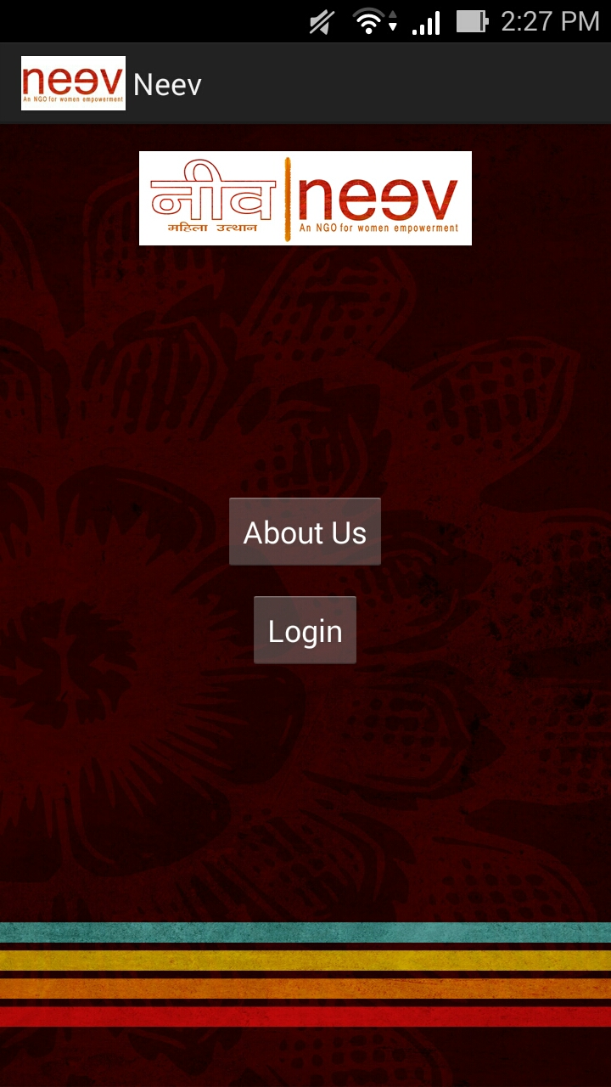
Main Activity
Home screen of the app
About Us
Log In
Flow : Launcher Activity

Slide 21

About Us Activity
About us screen of the app
Describes what is Neev
Objective of Neev
Flow : Main Activity/AboutUs

Slide 22
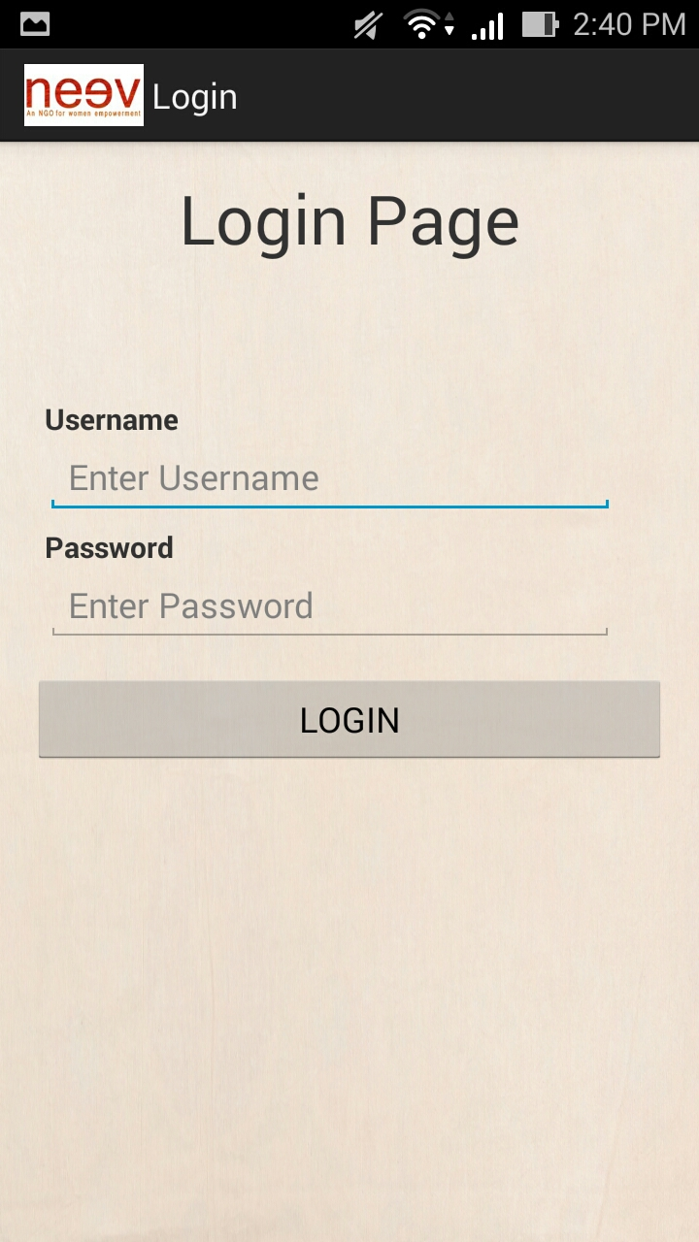
Login Activity
Login screen of the app
Driver Log In
Store manager Log In
Administrator Log In
Flow : Main Activity/Login
Notes:
Admin provides the user name and password to Driver and Store manager to operate the app. Authorises user’s credentials with the remote database. If successful, proceed to the next activity.

Slide 23
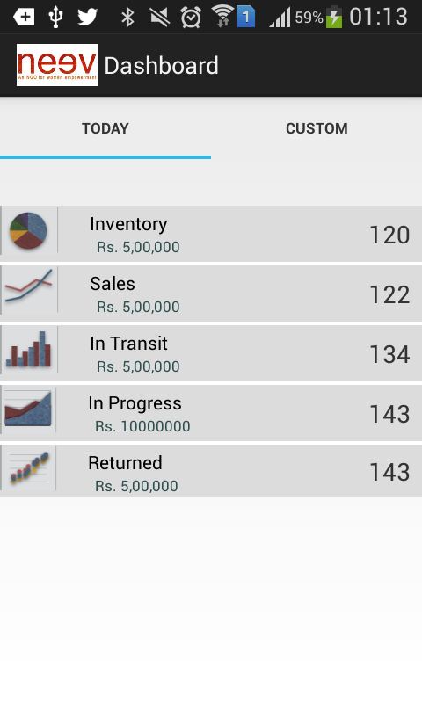
Dashboard Activity
Dashboard Screen
Today Tab (Opens by default)
Custom Tab
Flow : Login/DashboardActivity/TodayFragment
Notes:
Displays Today and Custom tab to track raw materials, sale of products, orders etc.
Tabs implementation : using Fragment
Adapter used : ActionTabsViewPagerAdapter for using ViewPager; ViewPager is used for displaying Tab’s data
Java file : ActionTabsViewPagerAdapter.java which contains ActionTabsViewPagerAdapter
Layout : Sliding Tab Layout (To embed sliding of tabs)
Package included : com.example.neev.view.SlidingTabLayout;

Slide 24
On the click of KPIs –
Inventory – Control passes on to Pie chart 1 which displays distribution of raw materials in percentage. Upon tapping, control moves to Pie chart 2, which displays the distribution of raw materials (actual units present). On tapping again, it displays the currency used to measure it.
Sales – Same control as above except in place of raw materials, furnished products is used.
In Transit – Same flow. Here Ordered products which are in transit is computed.
Returned – Same flow. Here Ordered products which have been returned by the customers is computed.
In Progress - Same flow. Here Ordered products which are not in {In Transit , Returned} are maintained

Slide 25
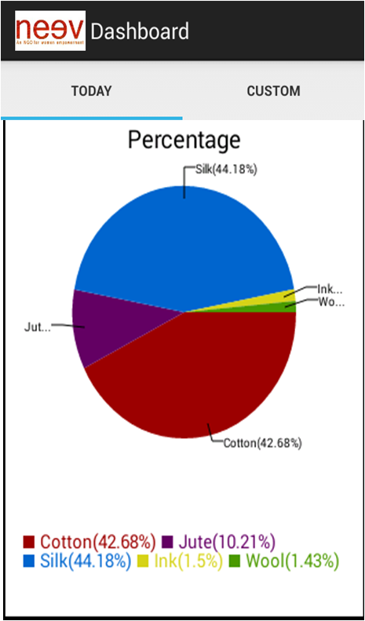
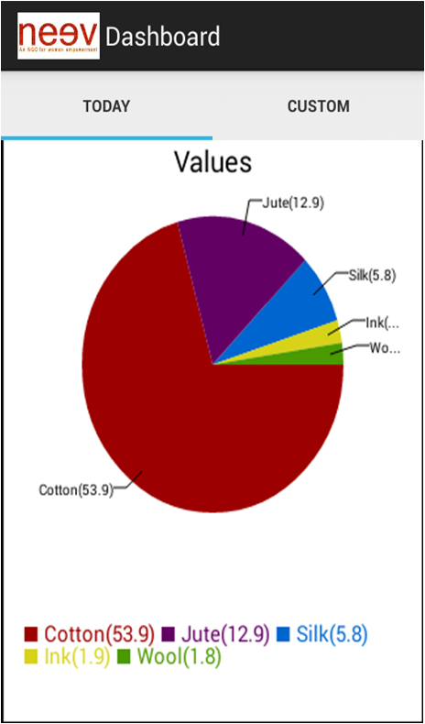
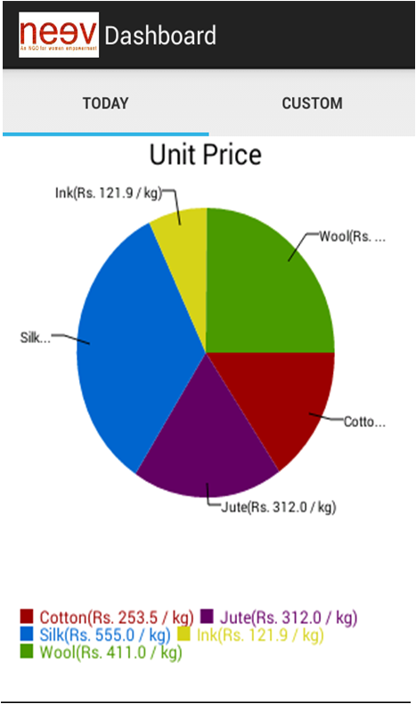
Flow in Pie Chart :

Slide 26
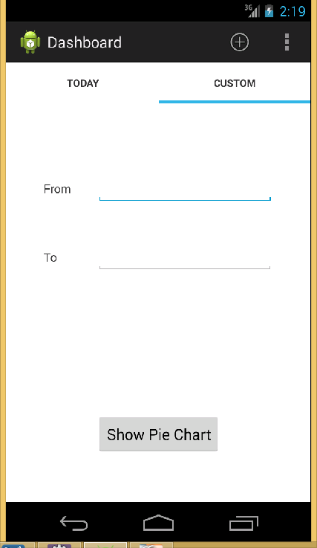
Custom screenshot and implementation
Pie chart generation using achartengine.
Display KPIs using ListView
Flow : Login/DashboardActivity/CustomFragment
Notes:
On the click of show pie chart, it displays KPIs (as in Today), On the click of KPIs the same function recurs as before. The difference is that here the pie chart is generated for range of dates selected. On Click of edit text it displays a dialog box which takes user input in date format. Implementation through Date Picker Fragment.
All date fields have been handled through this.

Slide 27
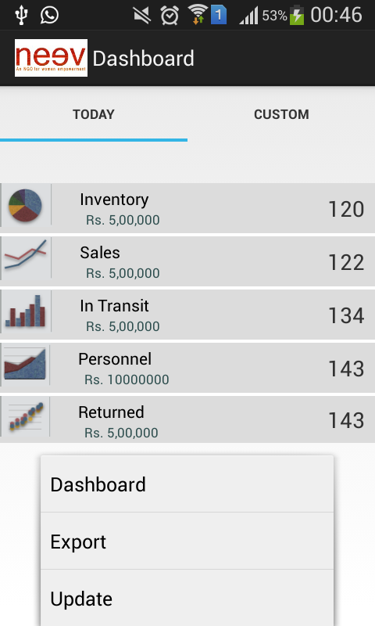
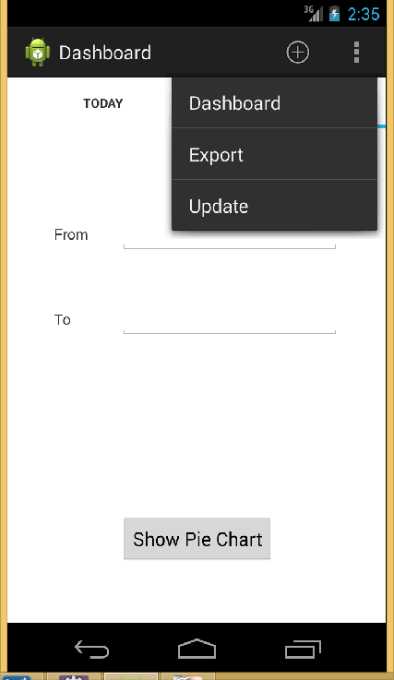
ACTION BAR OVERFLOW MENU
Notes:
One is through hardware button control and another is of overflow button menu.

Slide 28
Action bar item – Update Activity
Update Raw Material
Update Furnished Products
Place Order
In Transit
Delivery
Update Supplier Details
Update Customer details
Notes:
Operations which can be performed on click of Update activity. User friendly menu displayed.

Slide 29
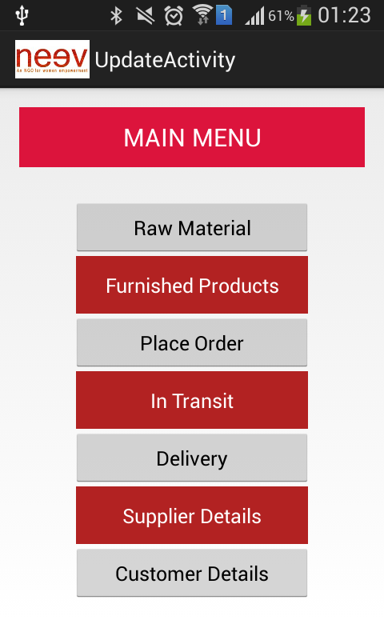
Flow : Overflow Menu/Update

Slide 30
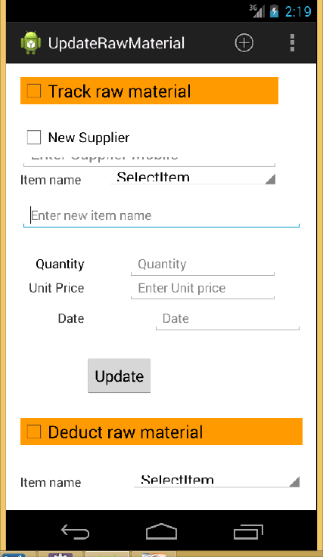
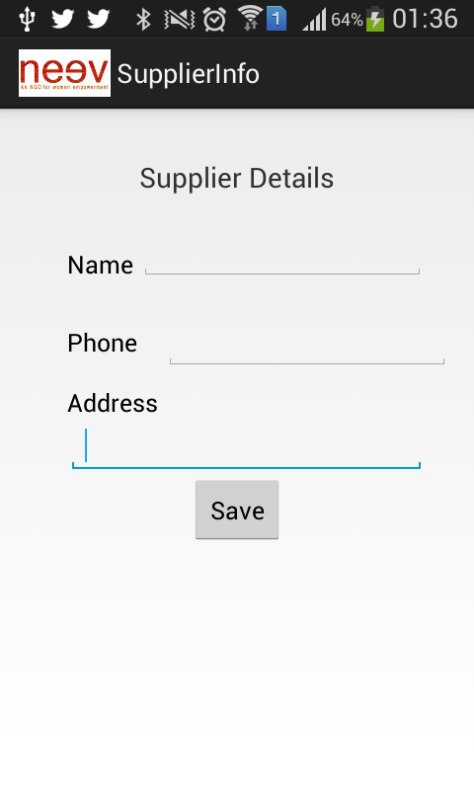
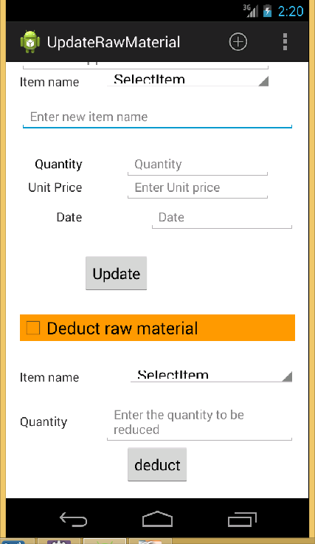
Update Raw material
Flow : Overflow Menu/Update/UpdateRawMaterial
Notes:
This activity keeps record of the raw materials - who supplied us the raw material, how much quantity and raw material consumption.
On click of new supplier check box, control goes to SupplierInfo.java which asks the details of new supplier. On click of save, it returns back to the update raw material activity. Then supplier phone is filled with the new entered supplier’s phone{through intent}. If customary supplier is supplying us the raw material no need of checking the check box. Item name – which the supplier is supplying to Neev, If the item name selected in the spinner is new item then : Enter new item name field appears to enter the new item otherwise it is invisible. Quantity bought, unit price at which the raw material is bought and the date on which the item is supplied is also tracked.
Since, Raw materials are consumed in making of furnished products, we have made a deduct raw material function, which deletes appropriate consumption of raw materials used in making the product. (We do not know the exact no. of units consumed in manufacturing a furnished product, we are entering the consumption units manually.)
Database effects :
New item entry will effect MATERIAL TRACK with new Item Id generated and the initial quantity supplied
Selection of Existing item will update the respective quantity of the item in MATERIAL TRACK
On click of update button, all the fields are recorded in RAW MATERIALS
On click of Deduct button, respective units of the item is subtracted from the MATERIAL TRACK
Supplier Details activity will effect SUPPLIER by adding new entry with the respective details entered.

Slide 31
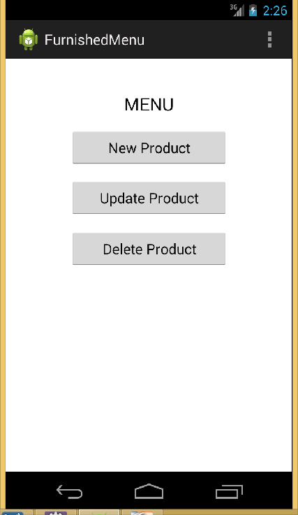
Furnished Products
Flow : Overflow Menu/Update/FurnishedProducts
Notes:
Takes care of furnished products.

Slide 32
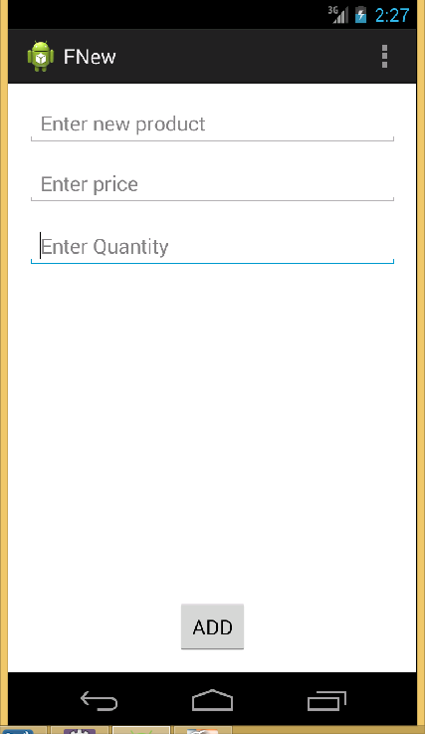
New Product
Flow : Overflow Menu/Update/FurnishedProducts/FNew
Notes:
Add new products for sale. Quantity of the products available in inventory, Price of each product are updated in this activity.
Database effects :
(1) Add new entry into FURNISHED PRODUCTS

Slide 33
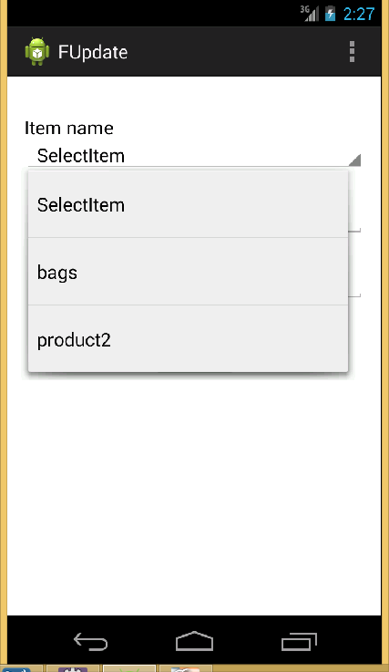
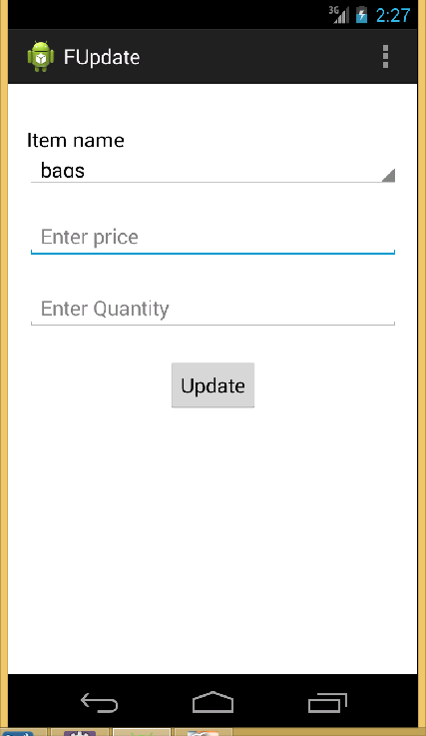
Update Product
Flow : Overflow Menu/Update/FurnishedProducts/FUpdate
Notes:
Update the price and quantity of furnished product.
Database effects :
(1) Update respective fields in FURNISHED PRODUCTS

Slide 34
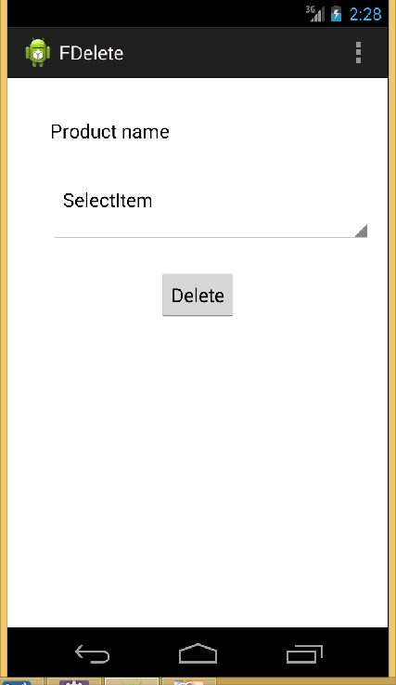
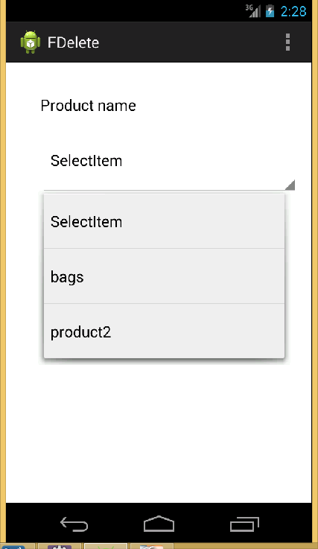
Delete
Product
Flow : Overflow Menu/Update/FurnishedProducts/FDelete
Notes:
Delete furnished products which are no longer in sale/manufactured.
Database effects :
(1) Delete entry named (product name) from the FURNISHED PRODUCTS

Slide 35
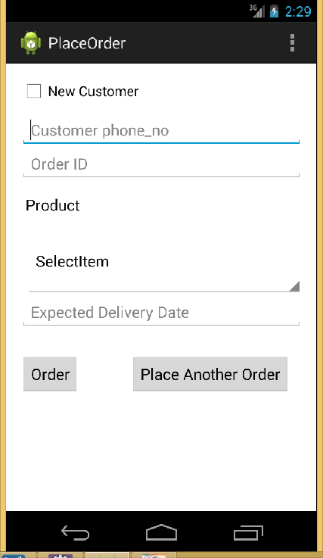
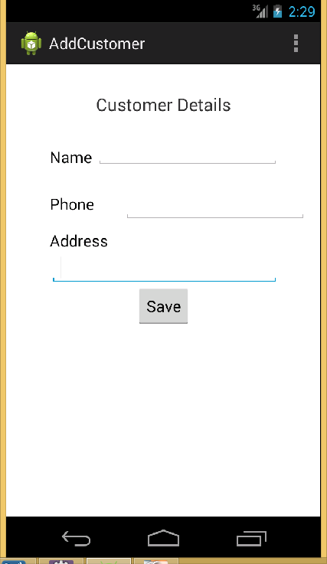
Place Order
Flow : Overflow Menu/Update/PlaceOrder
Notes:
We are maintaining a customer database. So, a order from a new customer first makes its way to the database by adding appropriate fields through AddCustomer activity. The phone no is retrieved in the customer phone no field of place order or otherwise manually enter the phone no. of an old customer.
Expected Delivery Date – date on which the product is expected to be delivered. If a single user orders different products, place another order is hit to record the next order.
Database effects :
A new complete entry is made in the customer table if the customer is new.
A new entry is also made in order_products table with new Order_ID, Product_Id of the product of which is being ordered, Customer_ID of the customer, Expected_Quantity of the product, Expected_Delivery_Date is set and Price is set by fetching from the Unit_Price of furnished_products table using Product_ID.
The Delivery_Status in order_products table is set “In_Progress”.
Booking_Date in order_products is set to the current date on which order is being placed.

Slide 36
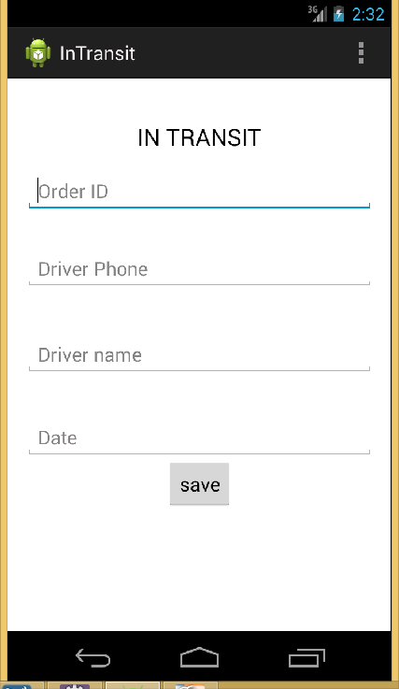
In Transit
Flow : Overflow Menu/Update/InTransit
Notes:
Takes care of orders which are en route delivery. Driver who is on duty to deliver the order to the customer.
Database effects :
Update the status to In Transit in ORDER PRODUCTS of the respective order.
Add a new entry in IN TRANSIT with the Driver name and Order no.

Slide 37
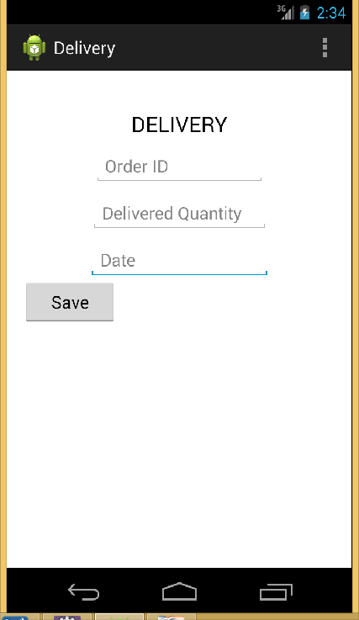
Delivery
Flow : Overflow Menu/Update/Delivery
Notes:
Set the status of the order as delivered and the delivery date is updated.
Database effects :
(1) Update the status to Delivered, Delivered On, Delivered Quantity in ORDER PRODUCTS of the respective order.

Slide 38
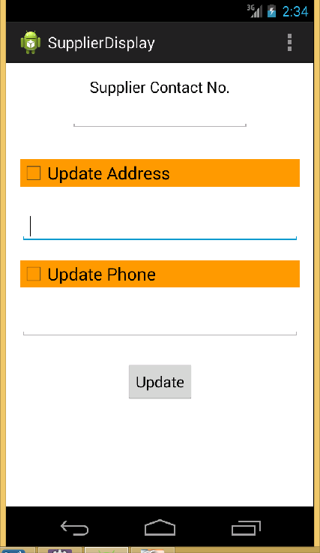
Update Supplier
Details
Flow : Overflow Menu/Update/SupplierDisplay
Notes:
Updates the address and phone no. of the supplier. Checkboxes are provided to update respective fields.
Database effects :
(1) Effects SUPPLIER table

Slide 39
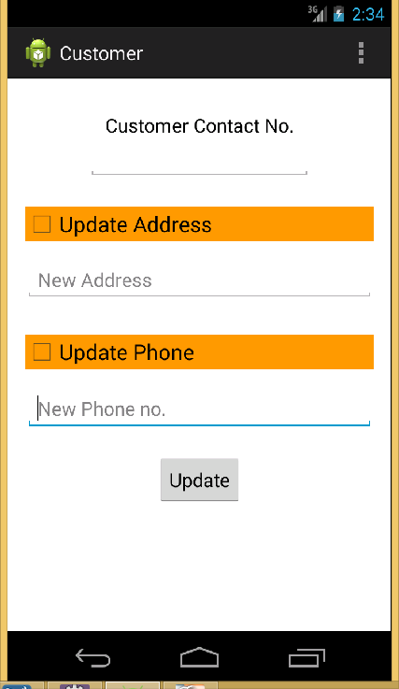
Update
Customer
Details
Flow : Overflow Menu/Update/Customer
Notes:
Updates the address and phone no. of the Customer. Checkboxes are provided to update respective fields.
Database effects :
(1) Effects CUSTOMER table

Slide 40
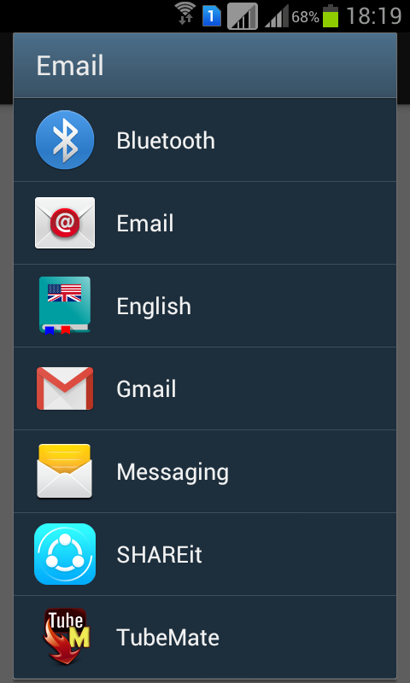
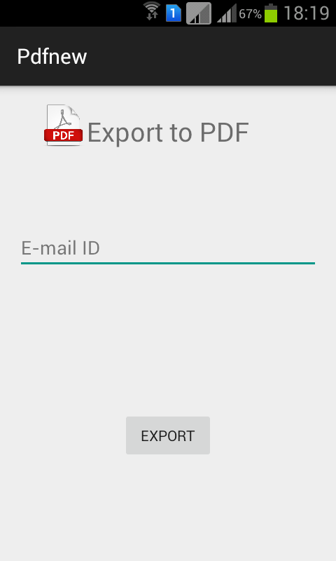
Export
Flow : Overflow Menu/Export
Notes:
Transforms the data in the database into PDF format on click of Export Button.

Slide 41
Steps for Running the Project
USING ECLIPSE MARS AND TOMCAT SERVER
1. Import the MainActivity as an Android Project.
File->Import->Android->Existing Android Code Into Workspace
Select the MainActivity Folder
Check Copy into workspace
2. Similarly import android-support-v7-appcompat located at
YourSDK\extras\android\support\v7\
3. Import webapp as a folder.
File->Import->General->Existing Projects into Workspace
Select the webapp Folder
Check Copy into workspace

Slide 42
Steps for Running the Project
4. Import mysqldump.sql into your mySQL database(either by using MYSQL Workbench or cmd)
Workbench steps :(Menu)Server->Data Import->Import from self-contained File->start-import
5. Right click on webapp->Run as->Run on server->Manually define a new server->Tomcat v7.0 Server->Select the installation directory->Finish
6. Right Click on MainActivity->Run As->Android Application
To run the App on Intranet, you'll have to keep your phone and the machine on which the server is running on the same network, best way we found is to connect both machines with same wifi and:
1)Replace String url = "http://10.0.2.2:8080/webapp/reg";
with String url = "http://ip of machine on network:8080/webapp/reg"; in all AsyncTasks classes.

Slide 43
Thank you

